Slide 1
Airbnb Rental Price Analysis
File created on: 8/17/2024 9:43:39 AM

Slide 2
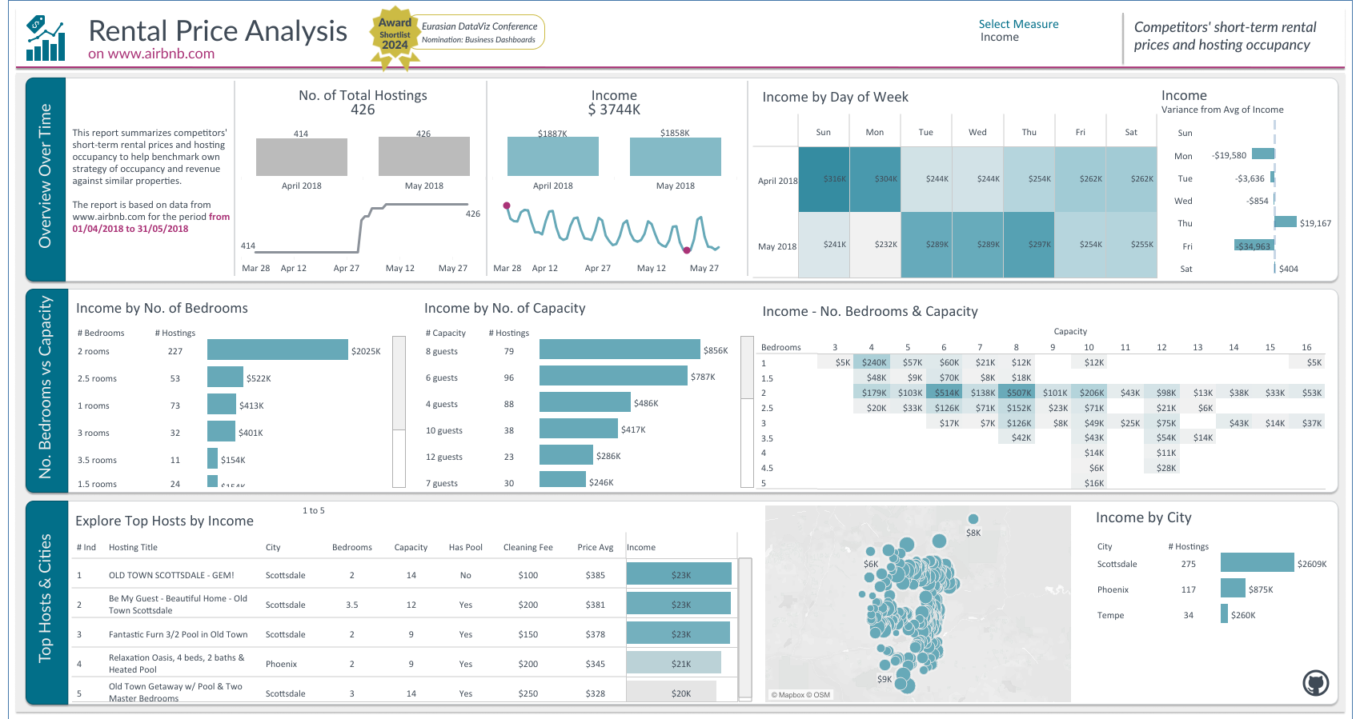

Slide 3
